Slide 1
The Power Flow: Boost up The Energy Transition
Bahman Ahmadi
Nataly Banol Arias

Slide 2
What is Power Flow?
Understanding Power Flow Analysis
Different methods for power flow
Factors Affecting Power Flow
What is optimal power flow?
Test cases for power flow methods
Framework
Results

Slide 3
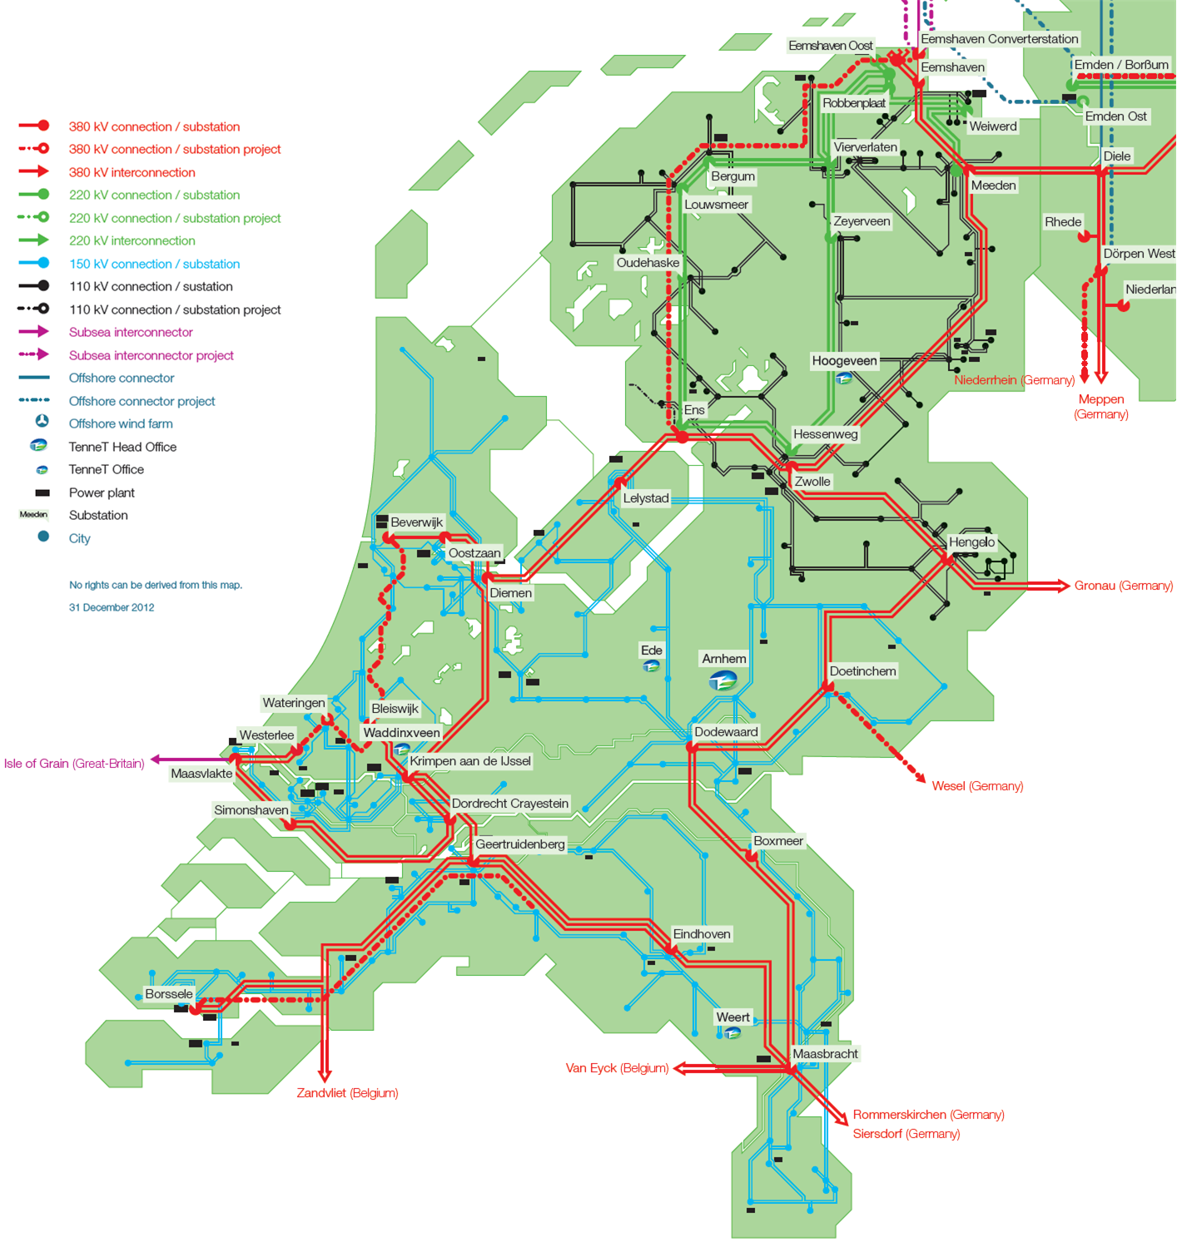
What is Power Flow?
Bus/node data
Power flow
Voltage
Line data
Current
Load data
Losses
Notes:
Power flow refers to the movement of electrical power through a power system. It is an important concept in electrical engineering, as understanding power flow is essential for designing, operating, and maintaining power systems. Power flow analysis allows us to determine the voltage, current, and power levels at different points in the system, which is critical for ensuring that the system operates safely and efficiently.

Slide 4

Understanding Power Flow Analysis
- It does not consider the time-dependent behaviour of individual assets.
- It determines the steady-state operating conditions of the power system (system has reached a balanced and stable state).
- In steady-state conditions, the time-dependent aspects of assets, such as dynamic behaviour or transient responses, are not directly considered.
- It uses simplified models that represent the characteristics of generators, loads, transformers, and transmission lines.

Slide 5
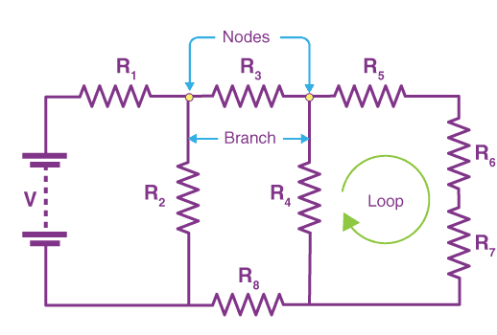
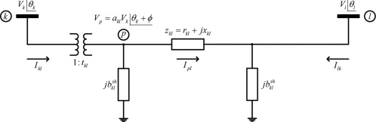

Different methods for power flow
- Kirchhoff's current law (KCL) and Kirchhoff's voltage law (KVL)

Slide 6
Different methods for power flow
Gauss-Seidel Method (1800s)
Newton-Raphson Method (1940s)
Fast Decoupled Method (1970s)
DC Power Flow Method (1950s)
Linear Power Flow Method (1960s)
Gauss-Jacobi Method (1800s)
Modified Newton-Raphson Method (1960s)
Decoupled Newton-Raphson Method (1980s)
Successive Substitution Method (1800s)
Z-Bus Method (1970s)
Forward-Backward Sweep Method (1990s)
Decoupled Power Flow Method (1980s)
Fast Decoupled Load Flow Method (1970s)
Gauss-Seidel Load Flow Method (1960s)
Hybrid Power Flow Method (2000s)
Laurent power flow (2022)
Tensor power flow (2023)

Slide 7
Factors Affecting Power Flow
Network Topology
Network Complexity
Load Modeling
Generation Modeling
Voltage Control Devices
Convergence Criteria and Initialization
Line Parameters
Transformer Models
Renewable Energies
Parallel Processing and Computational Resources
Software Implementation and Programming
…

Slide 8
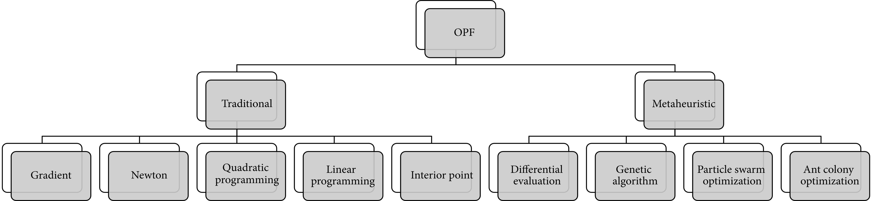
What is optimal power flow?
Optimal power flow!
Notes:
Finding the same result as the power flow but with respect to something?
SO it is optimization problem.

Slide 9
Test cases for power flow methods
Cases:
Time series data
Optimal EV charging
Data set for neural network
Network reconfiguration scenarios
Methods:
Newton-Raphson (NR)
Forward-Backward Sweep (FBS)
Gauss-Seidel (GS)
Fast Decoupled Method (FDM)
Laurent power flow (LPF)
Alliander Parallel-NR (APNR)
Tensor Power Flow (TPF)

Slide 10
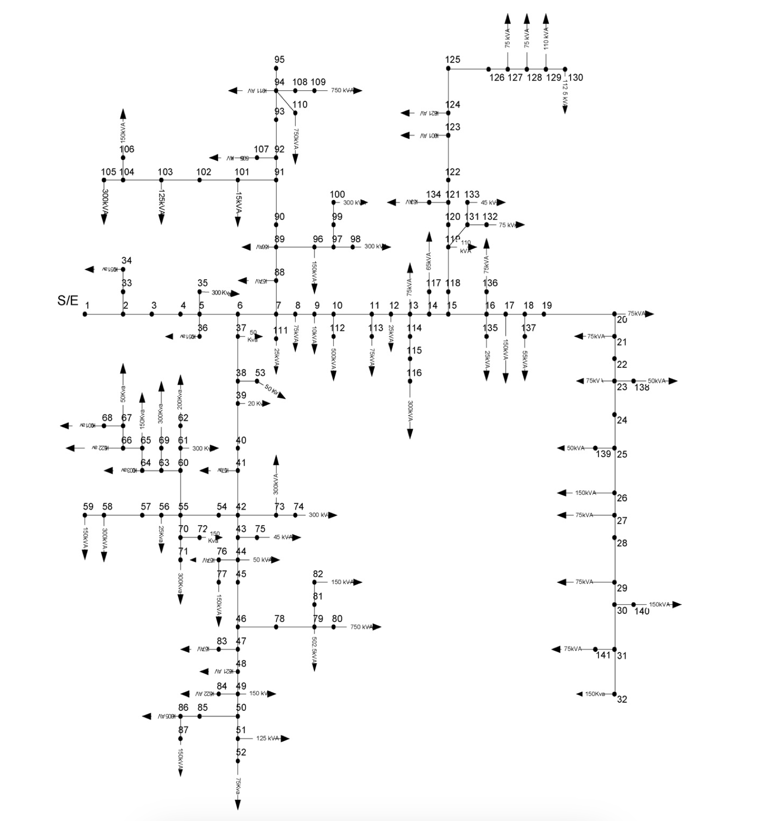
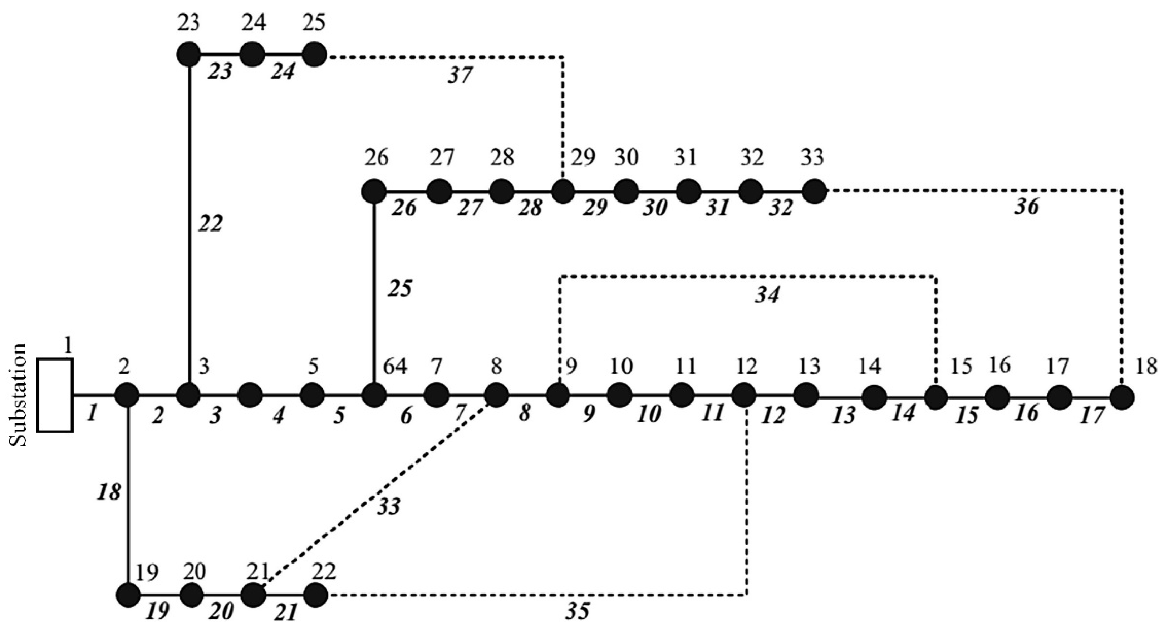
Test cases for power flow methods
Test systems: (balanced) - IEEE 33 bus distribution system
- Real distribution network in the metropolitan
area of Caracas (141 nodes)
1 Power flow | voltage/current for I time interval
96(15 min) power flows | voltage/current of the grid for a day
96(15 min) power flows for two reconfiguration | 2*96 power flows

Slide 11

Framework
Data needed for test systems:
- System base power and base voltage
- File with line data
FROM | TO | R | X | B | STATUS
1 | 2 | 0.0922 | 0.047 | 0 | 1
2 | 3 | 0.493 | 0.2511 | 0 | 1
3 | 4 | 0.366 | 0.1864 | 0 | 1
4 | 5 | 0.3811 | 0.1941 | 0 | 1
5 | 6 | 0.819 | 0.707 | 0 | 1
6 | 7 | 0.1872 | 0.6188 | 0 | 1
7 | 8 | 0.7114 | 0.2351 | 0 | 1
8 | 9 | 1.03 | 0.74 | 0 | 1
9 | 10 | 1.044 | 0.74 | 0 | 1
… | … | … | … | … | …
*The unit for R and X is Ω and for B is Siemens
R: resistance, X reactance, B: susceptance
More info:

Slide 12
Framework
Data needed for test systems:
- File with node data
NODES | Tb | PD | QD
1 | 1 | 0 | 0
2 | 0 | 100 | 60
3 | 0 | 90 | 40
4 | 0 | 120 | 80
5 | 0 | 60 | 30
6 | 0 | 60 | 20
7 | 0 | 200 | 100
8 | 0 | 200 | 100
… | … | … | …

Slide 13
Framework
Data needed for test systems:
- File with time series (active and reactive) data
date_time | node1 | node2 | node3 | node4 | node5 | …
01/01/2021 00:00 | 0.92192 | 1.08535 | 1.03155 | 0.86806 | 1.0808 | …
01/01/2021 00:30 | 0.92306 | 1.00039 | 1.01906 | 0.85849 | 1.0619 | …
01/01/2021 01:00 | 0.86027 | 0.99162 | 0.94294 | 0.85203 | 1.01434 | …
01/01/2021 01:30 | 0.82995 | 0.96715 | 0.93454 | 0.84378 | 1.00876 | …
01/01/2021 02:00 | 0.83449 | 0.95019 | 0.89685 | 0.81907 | 0.96421 | …
01/01/2021 02:30 | 0.8231 | 0.92372 | 0.89594 | 0.78499 | 0.94011 | …
01/01/2021 03:00 | 0.79348 | 0.90009 | 0.89211 | 0.84537 | 0.91336 | …
01/01/2021 03:30 | 0.82358 | 0.91016 | 0.9038 | 0.82988 | 0.92467 | …
01/01/2021 04:00 | 0.74396 | 0.92119 | 0.97023 | 0.78798 | 0.96998 | …
… | … | … | … | … | … | …
01/10/2021 23:00 | 0.95097 | 0.8824 | 0.96734 | 0.87998 | 1.02745 | …

Slide 14
Framework
Configurations
Get the line and node data
Use node and line data to create network
Data scenarios
Time interval scenarios
Get time series data
Calculate the power flow outputs

Slide 15
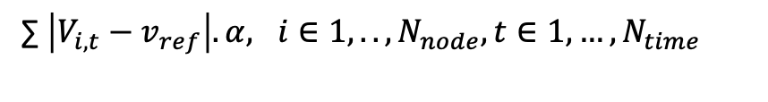
Results:
Time
Accurecy
- Error compare to pyomo solver result
- Index*:
∑ $\left|V_{i,t}−v_{ref}\right|.α, i∈1,..,N_{node}, t∈1,…,N_{time}$
Time series data.
Time for calculating the power flow outputs
Optimal EV charging
The ietarative process (heuristic, creating network, calculating power flow)
Data set for neural network
All process
Network reconfiguration scenarios
All process
* Some method give the slack node voltage output back

Slide 16
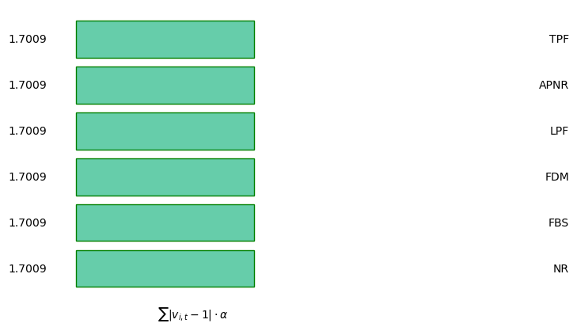
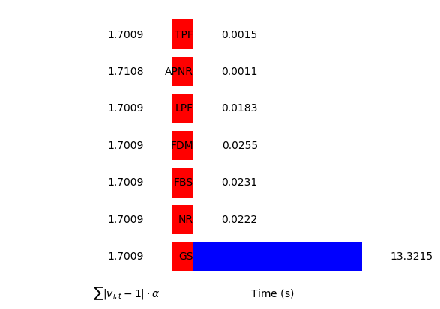
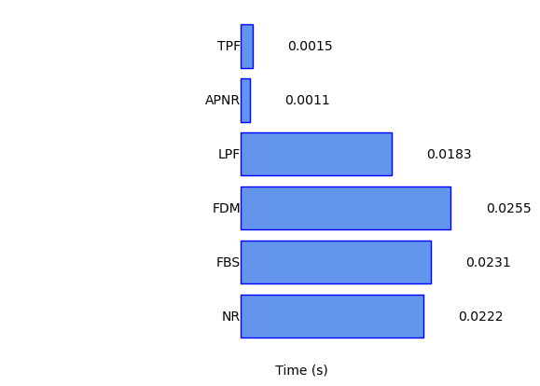

Results: Time series
One interval (1 PF):
33-node
>91%
Error is zero

Slide 17
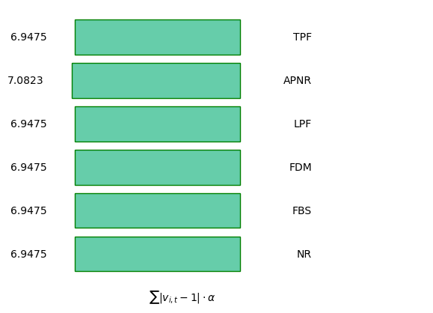
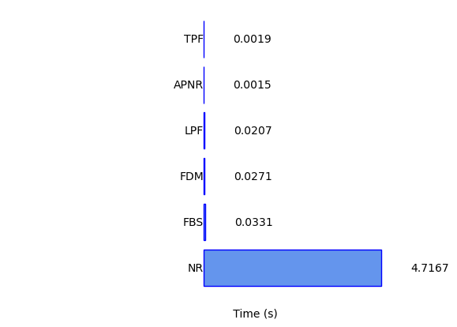
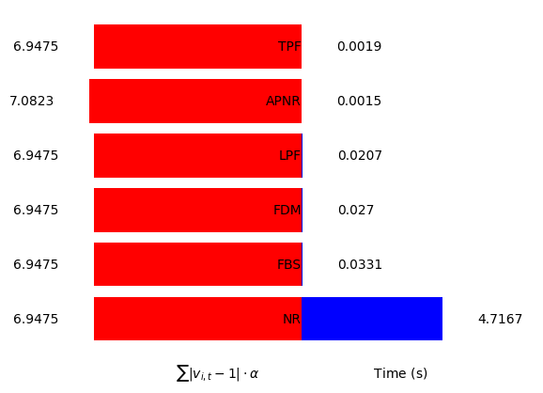
Results: Time series
One interval (1 PF):
141-node
>90%
*
*
* Note that the differences in the voltage magnitude values are after 6 digit (0.1 volt difference for 141 bus)

Slide 18

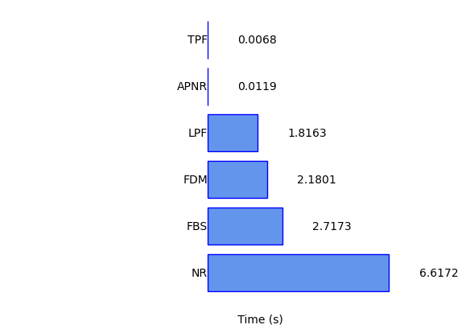
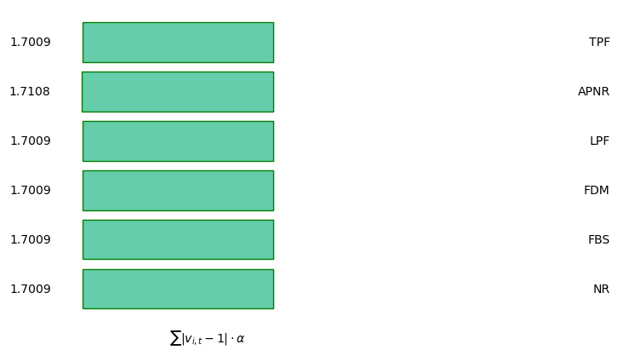
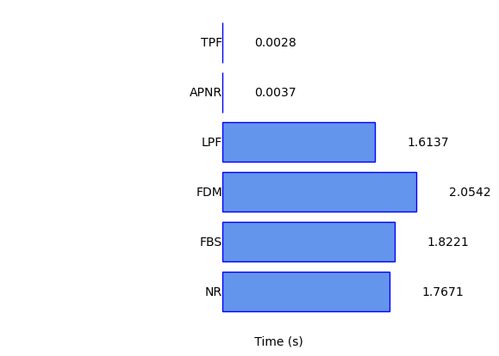
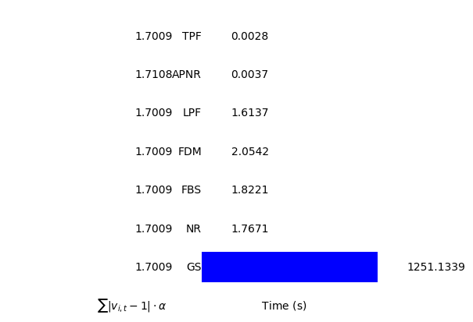
Results: Time series
96 interval (one day- 15 min) (96 PF):
33-node
141-node
>430
>150
times faster
times faster

Slide 19
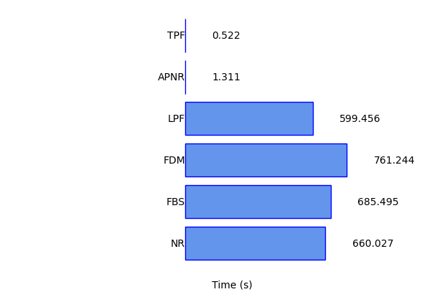
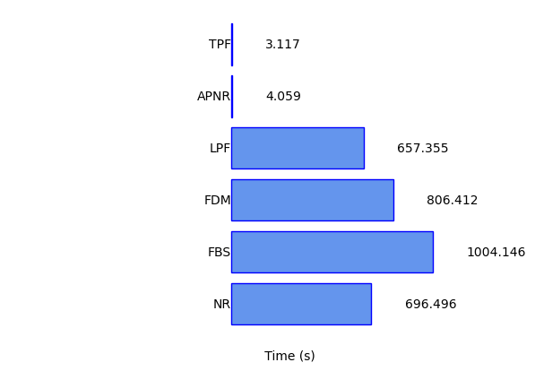
Results: Time series
365 day each 96 interval (35040 PF):
33-node
141-node
1136
210
times faster
times faster

Slide 20
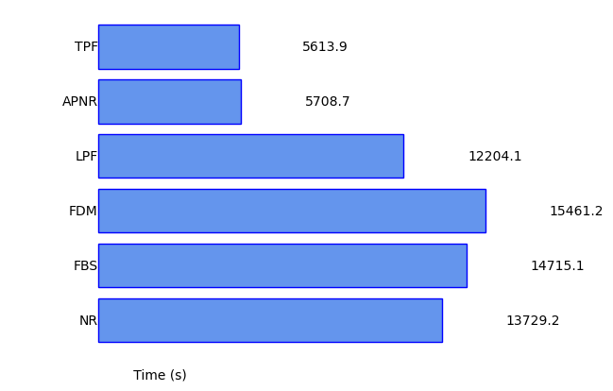
Results: Optimal EV charging
100 agent, 100 iteration, 95 interval (one day- 15 min) (960000 PF):
33-node
>2.1
times faster

Slide 21
Results: Data set for neural network
100000 scenarios of data each for 96 interval (96*100000 PF):
 | Loads |  |  |  |  | PV |  | EV
Data Scenario 1 | L1,1 | L1,2 | … | L2,1 | … | PV1,1 | PV… | EV1,1 | EV1,2 | …
Data Scenario 2 | L1,1 | L1,2 | … | L2,1 | … | PV1,1 | PV… | EV1,1 | EV1,2 | …
… | … | … | … | … | … | … | … | … | … | …
… | … | … | … | … | … | … | … | … | … | …
… | … | … | … | … | … | … | … | … | … | …
Data Scenario 100000 | … | … | … | … | … | … | … | … | … | …

Slide 22
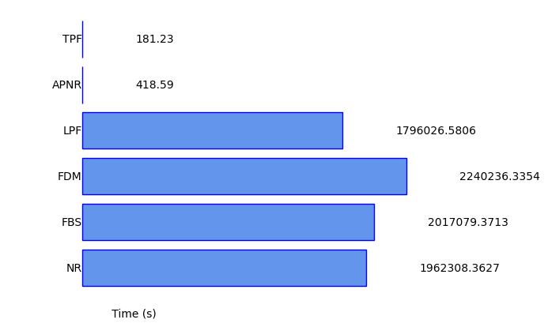
Results: Data set for neural network
100000 scenarios of data each for 96 interval (96*100000 PF):
33-node
>2.3
>9900
times faster
times faster
>20 Days
*One million data each for 96 interval (96*1000000 PF): Thermal struggle

Slide 23
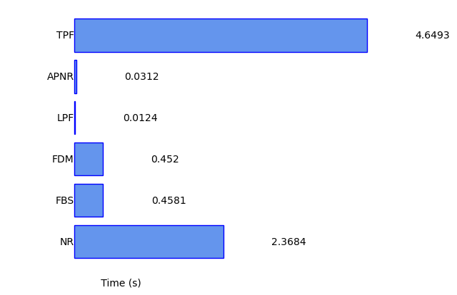
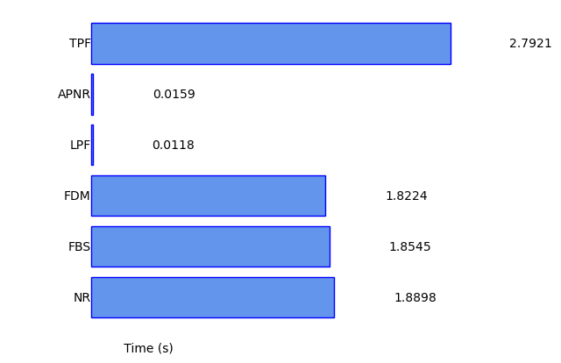
Results: Network reconfiguration scenarios
Time needed to create a network:
33-node
141-node

Slide 24
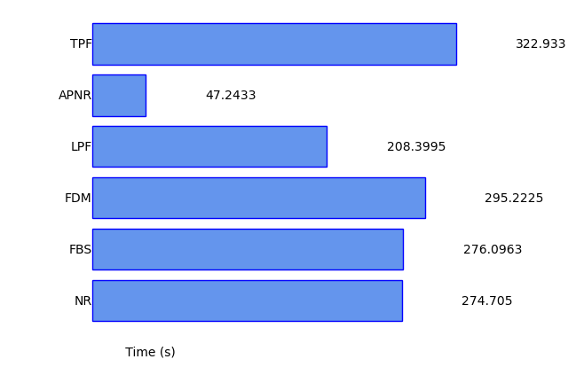
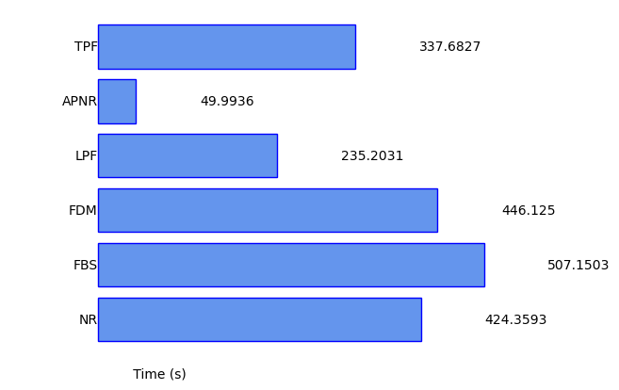
Results: Network reconfiguration scenarios
100 regonfiguration each with 96 interval (9600 PF):
33-node
141-node

Slide 25
TAKEAWAY:
Accuricy:
- All of them
Boost up:
- Time series data and Heuristic>> Tensor and Alliander
- Large data scenarios>> Tensor
- Reconfiguration>> Alliander

